Slide 1
Loops
Introduction to Python for Security

Slide 2
Course Path
Introduction to Python for Security
Introduction to Programming
Data Types
& Conditions
Loops
File System & Error Handling
Python for Security
Network Communication
Functions

Slide 3
Objectives
Loops
This lesson is an introduction to Python for and while loops.
During the lesson, management methods will be pointed out to emphasize organized and efficient code development.
For & While Loops
Loops & Conditions

Slide 4
For & While Loops
Loops

Slide 5

What Are Loops?
For & While Loops
Loops are blocks of code that run as long as a condition is true.
They allow repeating code logic for as long as the condition is true.
Notes:
Explain the main idea behind loops, why they are used, and how they can be used effectively.
Briefly review for and while loops. The differences between them will be explained later.
Explain the following:
For loops can repeat statements an x number of times.
For loops can repeat statements the number of times specified in a variable.
While loops repeat statements continuously, until something in the code block stops them.

Slide 6
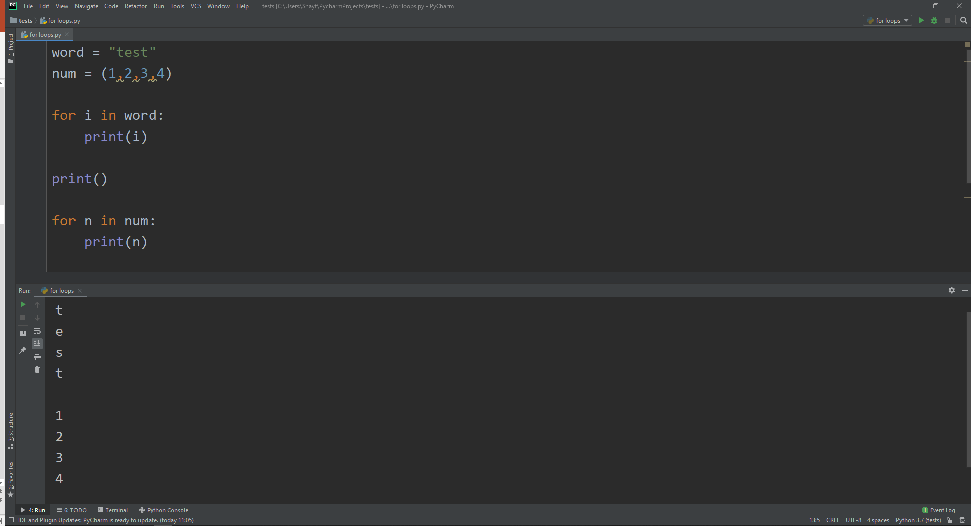
For Loops
For & While Loops
Perform blocks of code if the condition is true
A for loop provides iterating capabilities.
Can iterate over lists, defined ranges, and more
Notes:
Demonstrate how to use for loops in different contexts (like in the example).
Explain that in the example, the variables i and n can be used in any name.
Point out that an iteration over a sequence is known as traversal.
Describe the sequences (list, tuple, string).

Slide 7
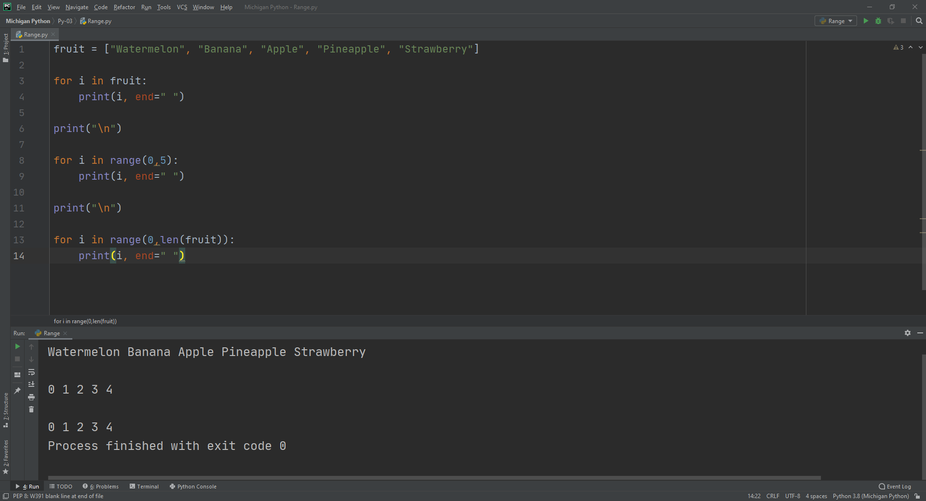
Range vs. List in Loops
For & While Loops
List iteration allows printing data.
A set range, defined by range(), is also capable of iteration.
A variable is defined within the loop as the iterating item.
Notes:
Demonstrate how to use ranges in lists and how for loops work (as in the example).
Explain why this method is effective.
A more detailed explanation of range will be provided later in the presentation.

Slide 8
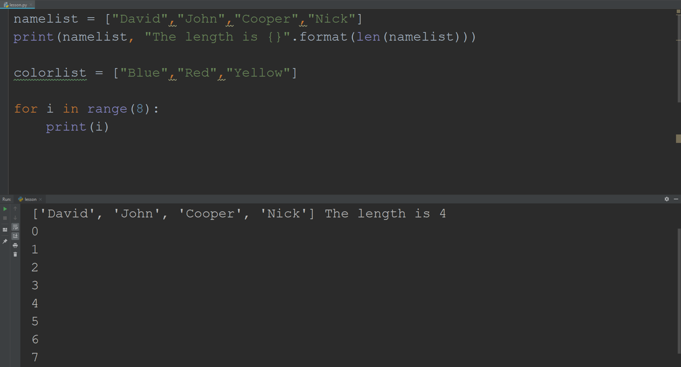
Calculate Loop Size
For & While Loops
The len() function returns the number of items of an object.
The range() function accepts an integer and returns the range of the object.
Notes:
Demonstrate the len() and range() functions.
Point out that len() can be performed on a list, string, or any other variable, while range() can be used to generate a sequence of numbers over time.
Describe when they are used in the code and how they can be effective.

Slide 9
Lab PY-03-L1
For & While Loops
Practice how to create a range with various inputs in a loop.
Range Loop
10–20 Min.
Request a range.
Iterate the range.
Display the iterated values.
Python 3
PyCharm
Lab document

Slide 10
Lab PY-03-L2
For & While Loops
Practice running nested loops.
Loops in Nested Lists
15–25 Min.
Open a new project in PyCharm, and create a list called Classroom.
Create a loop for classrooms.
Create a loop for students.
Python 3
PyCharm
Lab document

Slide 11
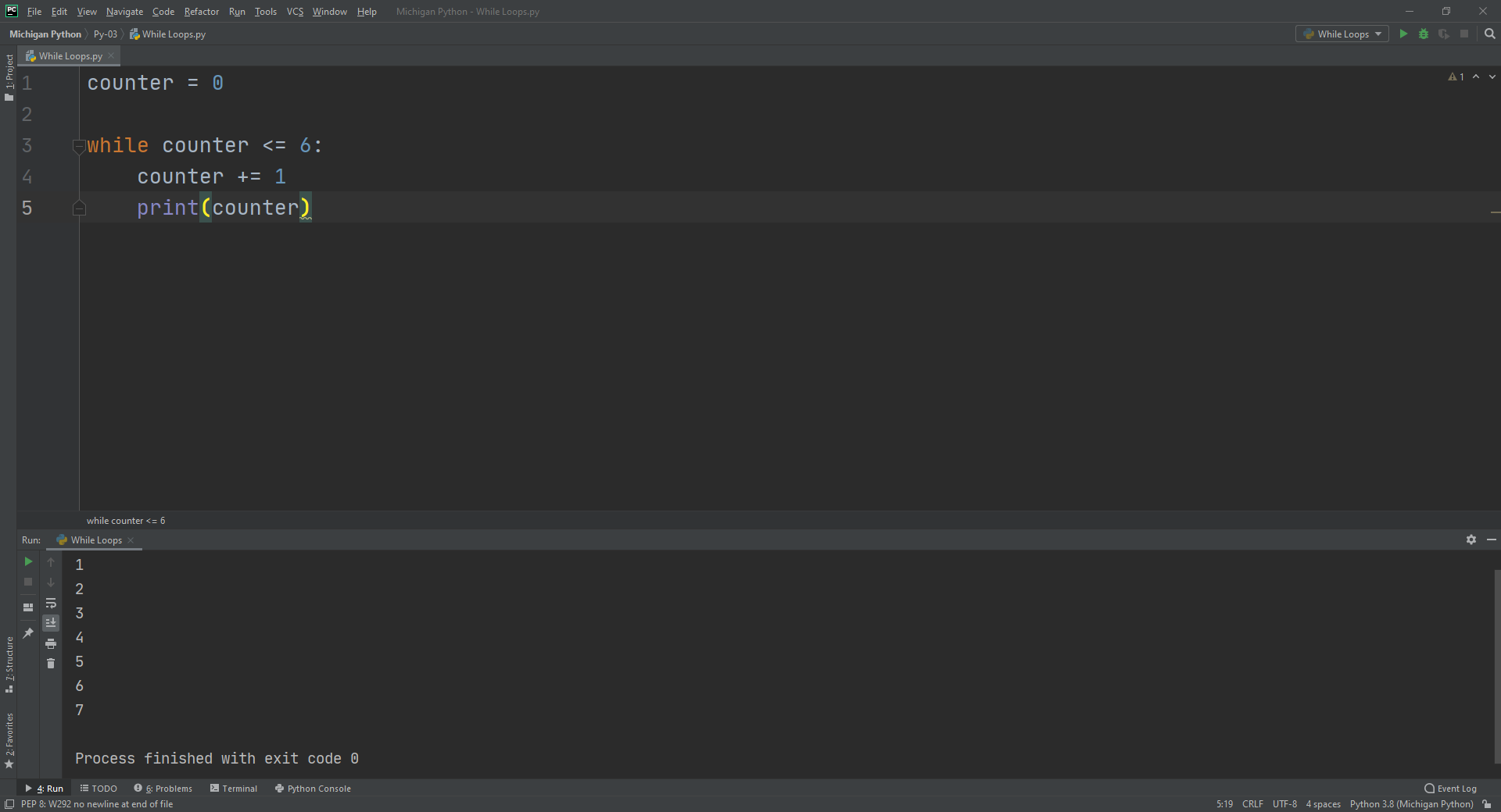
While Loops
For & While Loops
Perform a block of code while a condition is true
If the condition is false, the while loop will not be executed.
While loops do not have iteration capability like for loops.
Notes:
Demonstrate how to use while loops and point out the differences between while and for loops.
Explain that a condition usually depends on something that happens within the code block.
Explain that if a statement is false, the program will move on to the next code block.
Mention how break exits a loop if a specific condition is met.

Slide 12
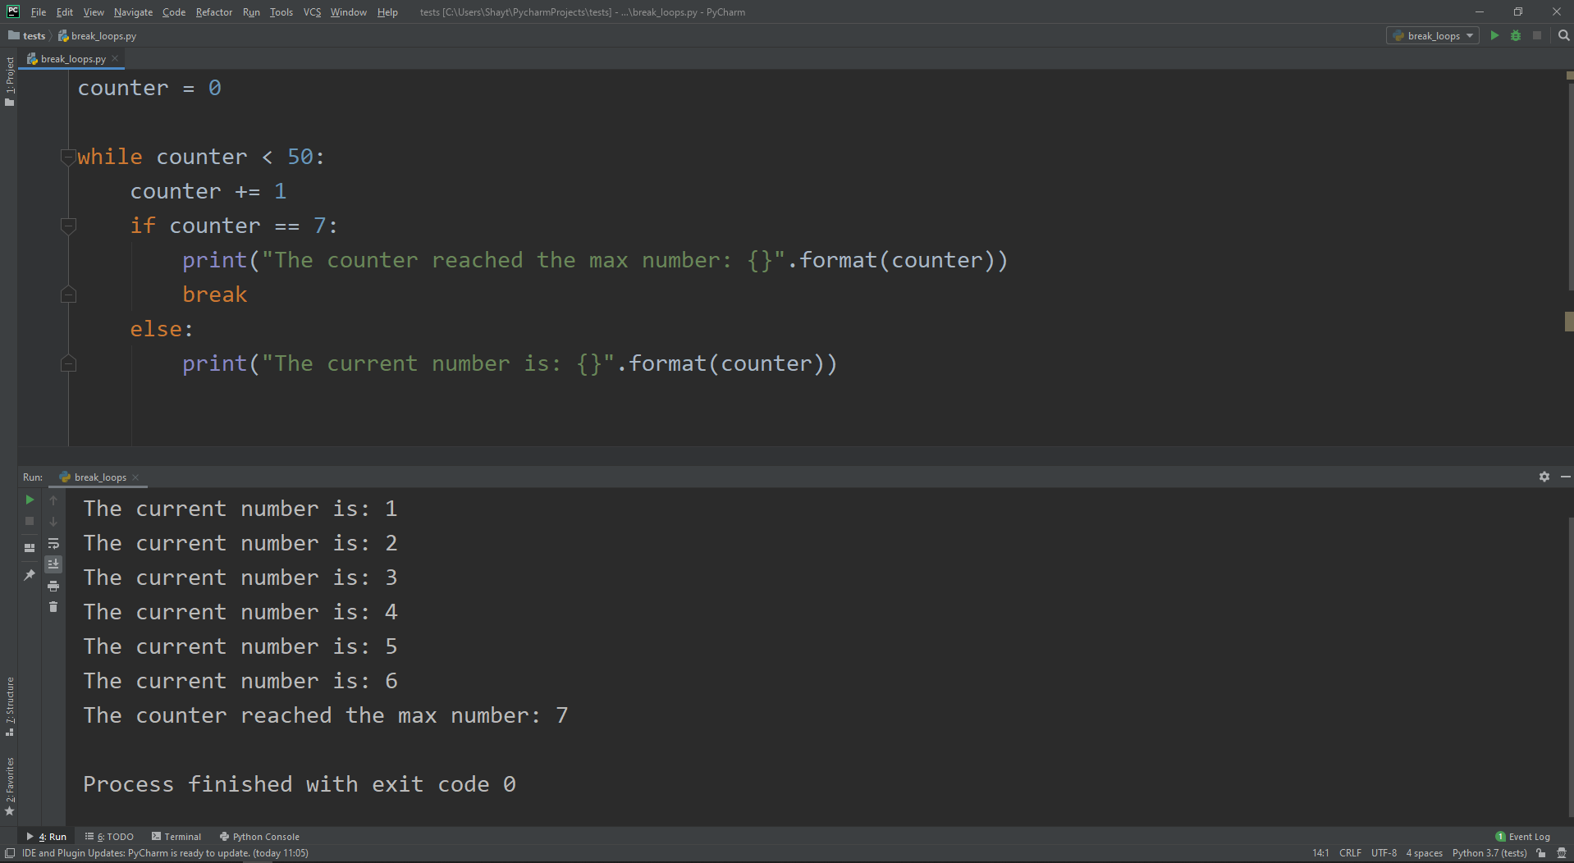
Break Command
For & While Loops
Both for and while loops can be interrupted.
The break command exits a loop.
Can be placed strategically for flow control
Notes:
Demonstrate how to use break in both loops and conditions.
Explain the code in the example.
Discuss when break should be used and how it can be effective in loops.

Slide 13
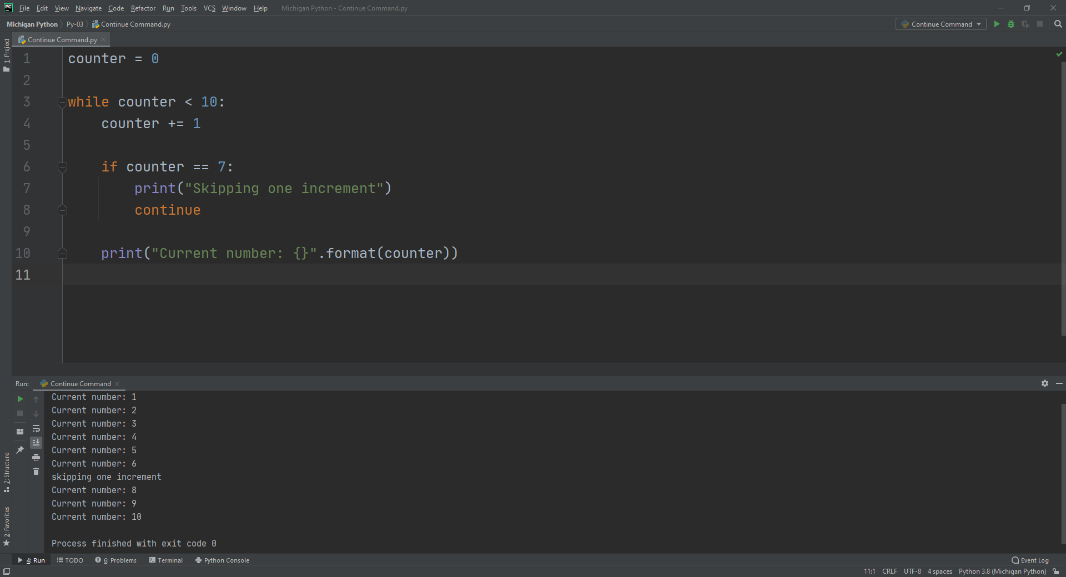
Continue Command
For & While Loops
Can be used in both for and while loops
The continue command skips an iteration.
Behaves as if the code reached the end of the block
Notes:
Demonstrate how to use continue in loops.
Verify that learners understand the difference between continue and break.
Explain the code in the example.
Point out when continue is used in a loop and how it can be effective.

Slide 14
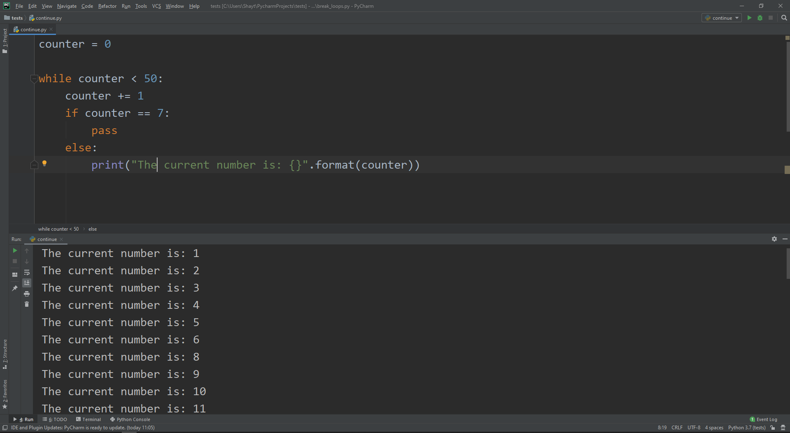
Pass Command
For & While Loops
Pass statements are used as empty executions.
This is useful for when we don't want to execute any code.
Pass can be used as a placeholder for future code.
Notes:
Briefly describe the code in the example.
Demonstrate how to use pass in Python and point out common uses.

Slide 15
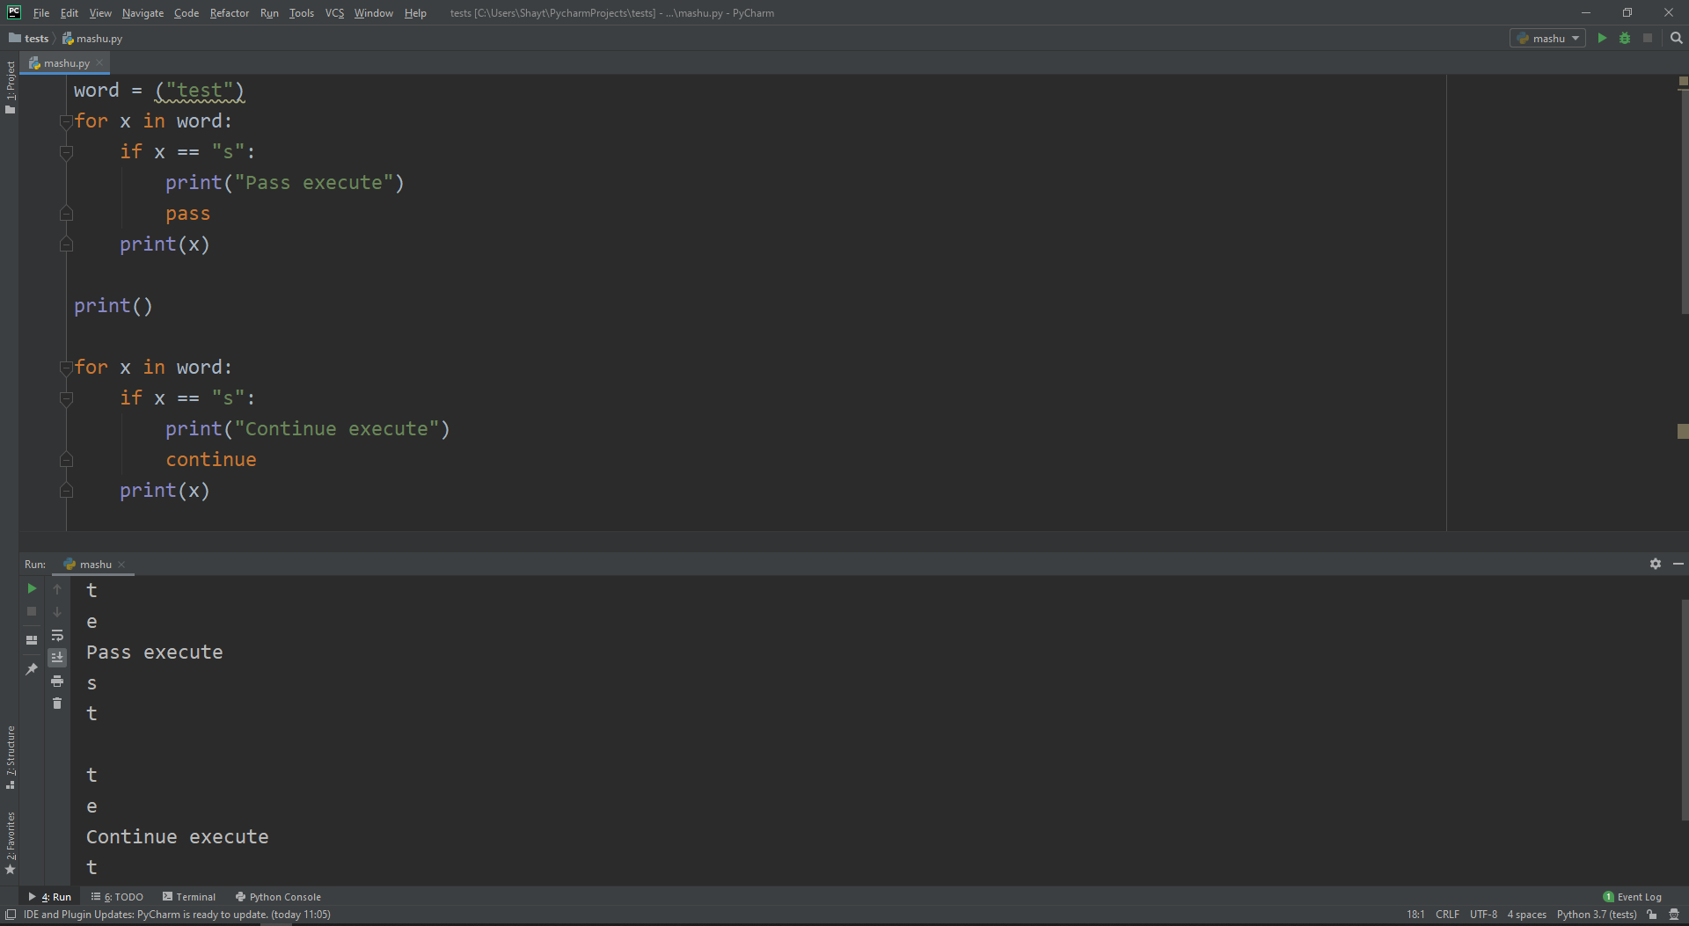
Pass vs. Continue
For & While Loops
Pass means move on to the remaining code or loop body.
Continue forces the loop to begin the next iteration.
Notes:
Explain the difference between pass and continue and where you would use them in the code.
Explain that continue will jump back to the top of the loop, while pass will continue processing the code.

Slide 16
Loops & Conditions
Loops

Slide 17
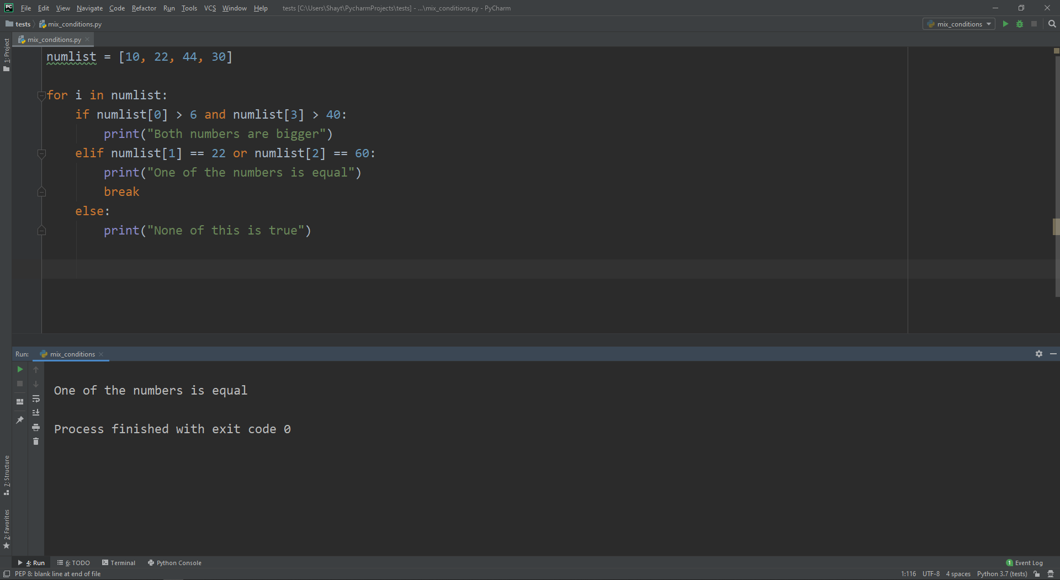
Mixing Conditions and Loops
Loops & Conditions
Conditions have a major role in a loop’s flow control.
They provide greater flexibility for loops.
They also ensure more efficient conditional checks and help build a better code writing structure.
Notes:
Briefly explain the code in the example.
Demonstrate how to use conditions in loops and how they can be effective.
Mention that the difference will be at the end where break will be used in while loops.
Mention that by mixing conditions and loops, different checks can be performed on iterating objects, and outputs can be displayed accordingly.

Slide 18
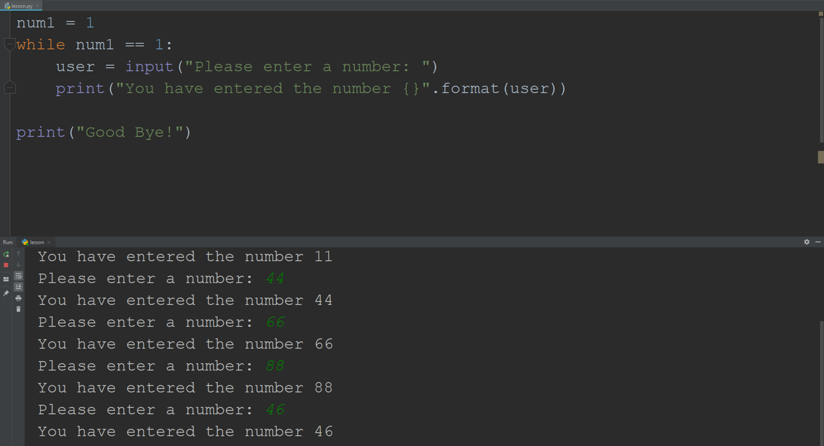
Infinite Loops
Loops & Conditions
A loop becomes infinite if a condition is never false.
To avoid an infinite loop, the loop must verify the existence of a false condition.
Notes:
Briefly explain the code in the example.
An infinite loop will occur if a while loop’s condition is always true.
Demonstrate what an infinite loop looks like and how to avoid it.
Mention that infinite loops will typically occur in while loops.
Point out that the print function in the example will never be executed.

Slide 19
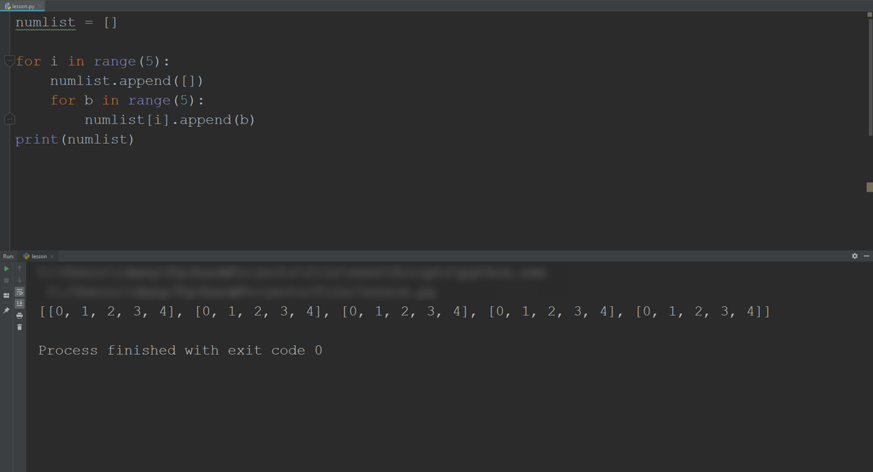
Nested Loops and Lists
Loops & Conditions
The append() function can be used to define a list within another list.
append() adds a value to an existing variable.
Nested lists can be used to arrange data in hierarchical structures.
Notes:
Explain nested lists.
Briefly explain the code in the example.
Demonstrate how to perform a nested loop and verify that learners understand how it is done.
Discuss the append() function and how it should be used.

Slide 20
Lab PY-03-L3
For & While Loops
Practice executing code with a while loop and conditions.
Loops with Conditions
10–20 Min.
Create a counting mechanism.
Locate a specific value when counting.
Python 3
PyCharm
Lab document

Slide 21
Lab PY-03-L4
For & While Loops
Work with input from users to control program flow and insert and retrieve the desired output.
User Dictionary
15–20 Min.
Create an empty dictionary and two variables.
Identify the service.
Print the final dictionary if the user breaks the loop.
Python 3
PyCharm
Lab document

Slide 22
Lab PY-03-L5
Loops & Conditions
Implement conditions to control infinite while loops.
While and Conditions
30–50 Min.
Create a list of groceries with an available budget.
Iterate the list for budget calculation.
Simulate grocery shopping.
Python 3
PyCharm
Lab document

Slide 23
Questions?
Thank You

